Slide 1

Automatic reassignment of high priority breached ticket
Zoho Desk

Slide 2
Goal -
The outcome of this use case is the reassignment of high priority breached open ticket to higher team after 7 days of Open .

Slide 3
Implementation Stage 1: Create an assignment rule
Log in to Zoho Desk with Administrator privilege.
Go to Setup > Automation > Assignment rules > Direct assignment

Slide 4
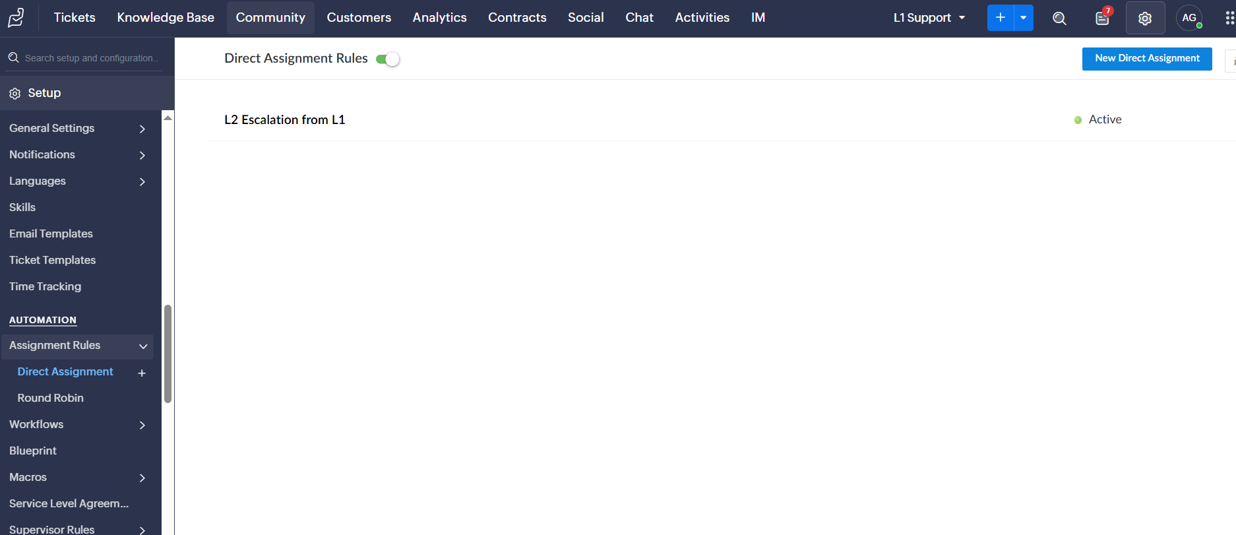

Slide 5
Implementation Stage 2: Create rules based on criteria
Click on "New Direct Assignement" candidate details.
Set rule name & Description and Add target
Set the criteria as -
Set the criteria as -
Status is open
Priority --> high
Resolution is Empty
And Overdue is true

Slide 6
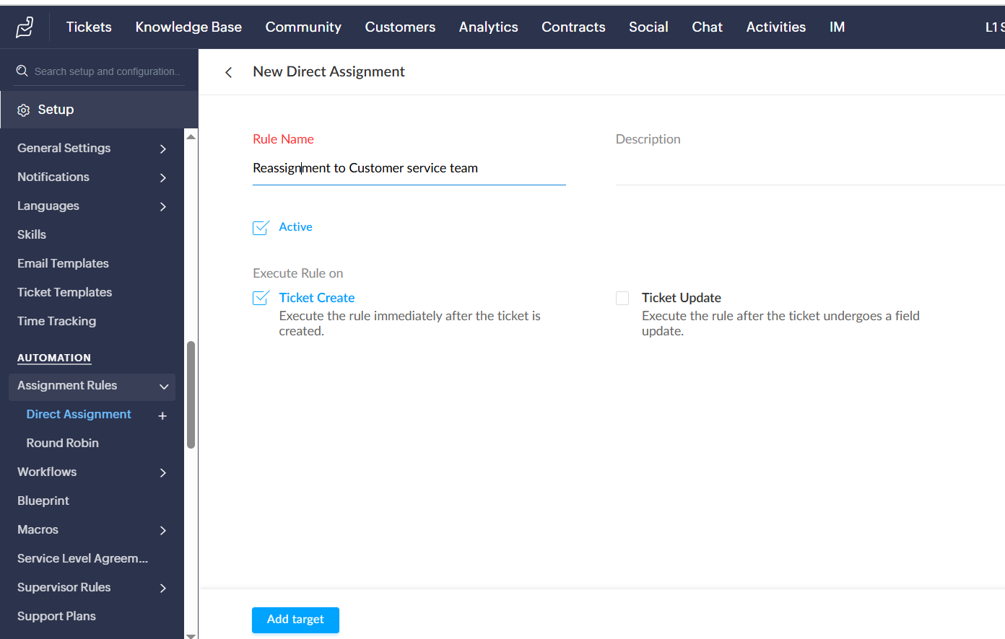

Slide 7
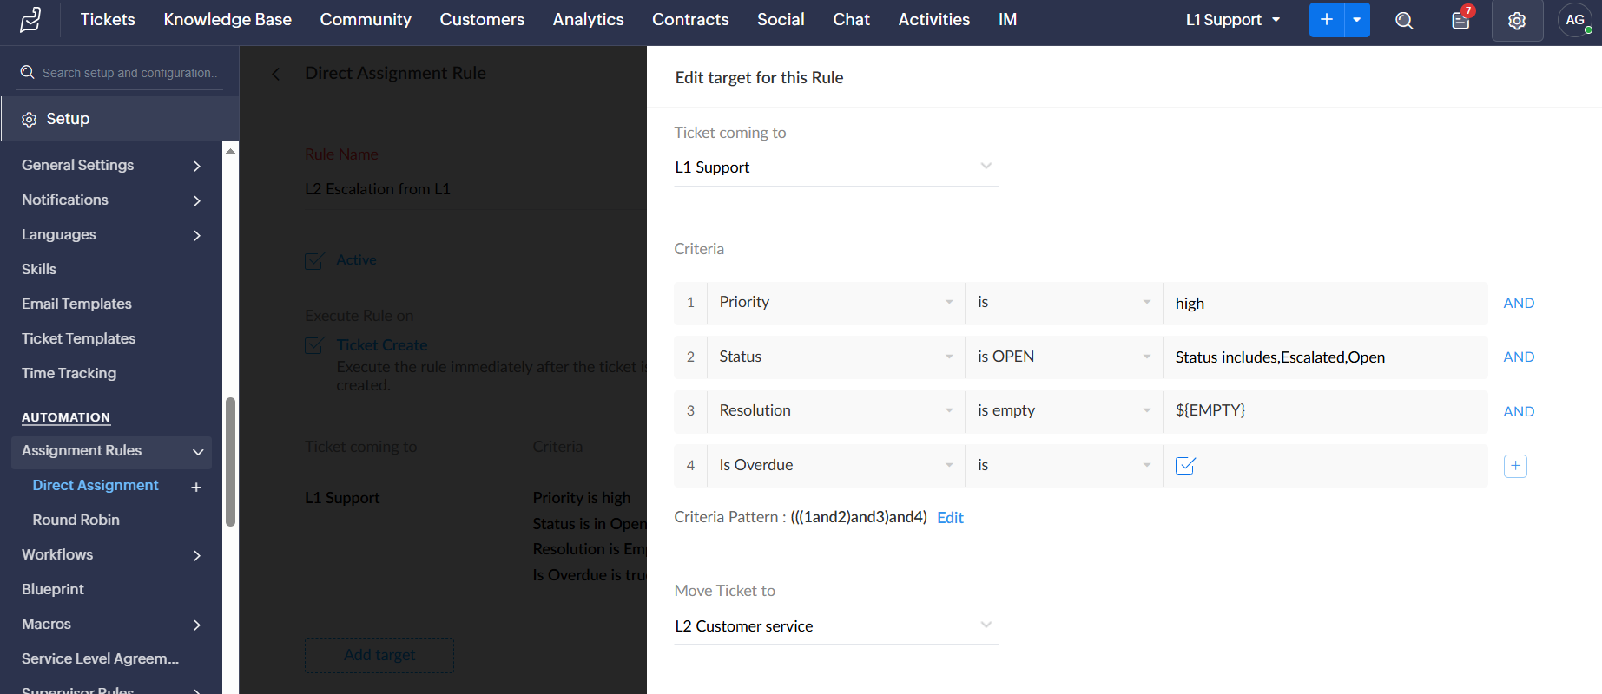

Slide 8
Once the rule is saved , this rule will trigger daily .If there is any ticket found matches with the criteria as mentioned will move(escalate) the ticket to Customer service .

